Slide 1
Meta Learning
May 3

Slide 2
Goal
Enable the model to learn a new task from a small amount of new data quickly.

Slide 3
Generic training process of neural net
https://medium.com/huggingface/from-zero-to-research-an-introduction-to-meta-learning-8e16e677f78a

Slide 4
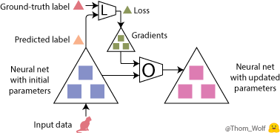
Generic training process of neural net
https://medium.com/huggingface/from-zero-to-research-an-introduction-to-meta-learning-8e16e677f78a
Notes:
Initial parameters

Slide 5
Turn to Meta Learning

Slide 6
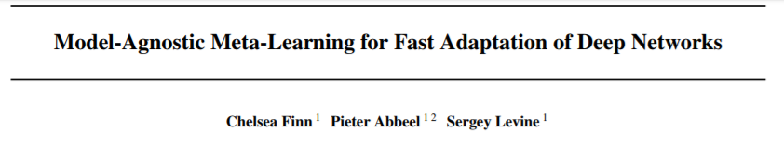

JMLR paper
Goal:
Enable the trained model to learn a new task from a small amount of new data quickly.
Problem Setting
model (f) outputs ‘a’ for the input ‘x’
task-specific feed back
distribution over initial observation
distribution over all task

Slide 7
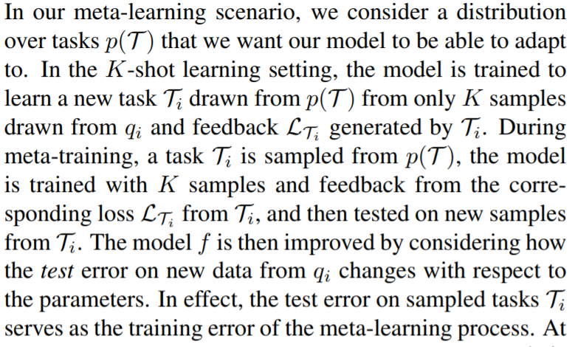
JMLR paper
Compared with K-shot:

Slide 8
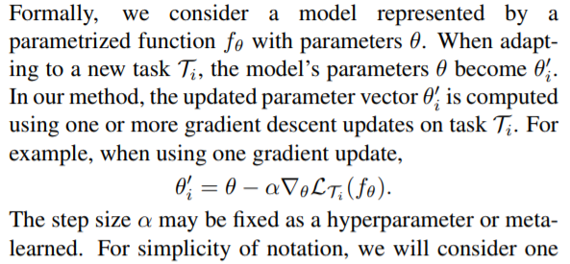
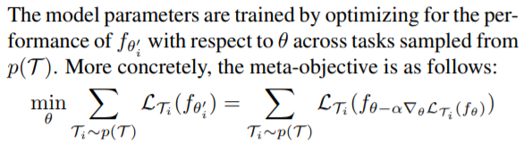
MAML model
Step 1:
Step 2:

Slide 9
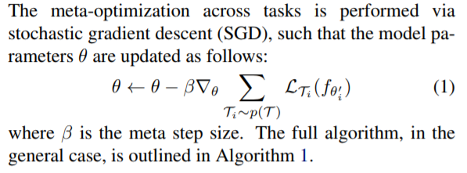
MAML model
Step 2:
Step 3:

Slide 10
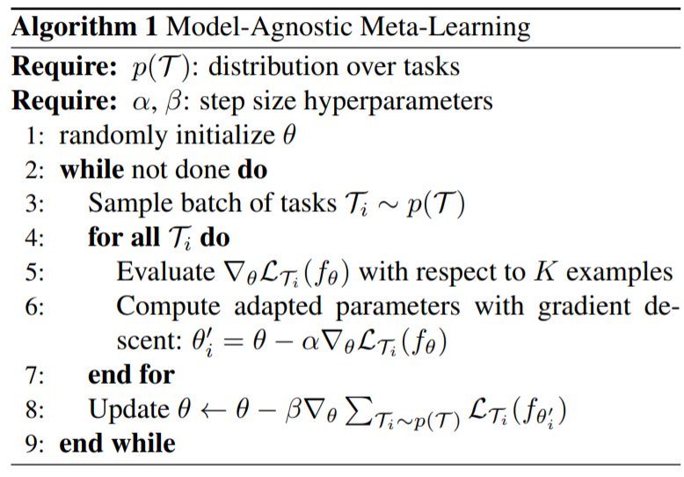
MAML model

Slide 11
MAML in few-shot learning

